Slide 1
Mutation Station
Team 1007 - Grape Slushie Studios

Slide 2
Introduction
IMGD 4000 - Developers
Jonas Mcgowan-Martin, Team Lead and Overwatch Tank Expert
Chris Griffin, Sphugr, Bugr, and Dugr Creator
Natasha Kononenko, Fluent Russian Speaker
Nick Wong, IMGD Minor Expert and Alpha World Record Holder
IMGD 4500 - Artist
Liam Miller, Thriller Animation expert
Website
nswong.github.io/IMGD4000

Slide 3
Elevator Pitch
“A third person boss-rush combat game where you are an astronaut trapped in a destroyed space station. Fight through your mutated former colleagues and take their equipment to escape the station before you succumb to the exposure of space.”

Slide 4
Major Art and Technical Features
Player Controls
Opponent AI
3rd-person Camera
Directional Audio
Randomized Boss Order
Weapons/Tools inspired by Real Astronaut Gear
Modular Level Designs build for specific combat scenarios/styles

Slide 5
Overview
Objective: Defeat each boss to move onto the next room. Defeat all bosses to win the game.
Basic Controls:
W: Forward
A: Left
S: Backwards
D: Right
Left-Click: Drill
Hold Left-Shift: Sprint
Spacebar: Jump
Advanced Controls:
Right-Click: Fire laser
Hold Right-Click: Charge laser,
Release Right-Click: Fire charged laser
Hold Spacebar: Use Jetpack, consumes Fuel resource
Press E: Fire Grappling Hook
Hold E: Pull towards target location Release E: Release Grappling Hook

Slide 6
Laser
Unlocked by defeating Quartermaster Volskoi
Long-range weapon
Spammable but low damage (with cooldown)
Can charge up for more damage
Player slowed while charging
Press right-click to fire
Hold right-click to charge up
Release right-click to fire charged laser
Notes:
Picture of boss instead of icon

Slide 7
Jetpack
Unlocked by defeating Cerberus the Canine Cosmonaut
Aerial Mobility Equipment
Consumes Fuel Resource
Regain Fuel by not using Jetpack
Hold Spacebar to activate
Release to fall down
Notes:
Picture of doggo

Slide 8
Grappling Hook
Unlocked by defeating Doctor Grabapple
3D-Maneuverability Equipment
Uses a cooldown system
Pulls player towards target location
Press E to launch grappling hook
Hold E to pull player towards hook
Release E to unhook
Notes:
Show boss

Slide 9
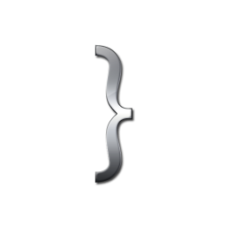
Bosses
Ordinary Bosses:
Quartermaster Volskoi
Cerberus the Canine Cosmonaut Randomized Order
Doctor Grabapple
Final Boss:
S̶̛̻͛̍͐̓̊̋͠E̷̖̓̊̀̽̈́̂͘̚N̴̥̫̯͗ͅS̷̹̅̏̿͊̎͛͂͝͝Ư̷̬̇̐̔Ŝ̶̪͍̎͌̑͠ ̴̻̞̀̋̉̾͠͝S̷̢̛͍̻̮͈̩̣̊̉͌͗̓ͅU̶͖̬͖͎̦̱̍̏̂͗Ḭ̴͌͛̓
Notes:
http://cdn.mysitemyway.com/etc-mysitemyway/icons/legacy-previews/icons-256/glossy-silver-icons-alphanumeric/070957-glossy-silver-icon-alphanumeric-bracket-curley2.png
Maybe show bosses here

Slide 10
Cutscenes
Made using UE4 Cinematics editor (Sequences)
Cutscene plays for each room
Introduces environment
Introduces boss
60 FPS
10 seconds each
Notes:
https://pixabay.com/p-146180/?no_redirect

Slide 11
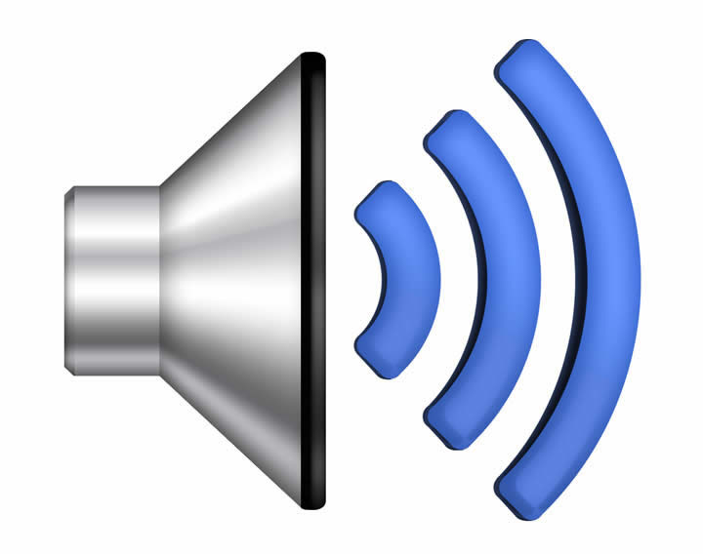
Directional Audio
Weapon audio assets
Drill
Laser
Voice-Over audio assets
Normal Dialogue VO
Authentic Russian VO
Authentic Breathing VO
Real Dog VO
Other audio assets
Footsteps
Doors
Ambience
Soundtrack
Notes:
http://anguerde.com/TTF-228408-audio.html

Slide 12
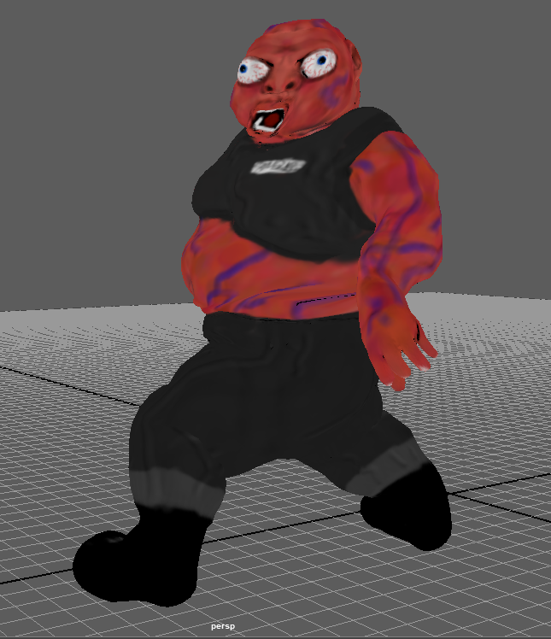
Art Aesthetic Design Features
Creepy/Humorous Feel
Weapons and gear consisting of authentic Astronaut Tools
Capture the feel of a true space theme inspired by real space station and sci-fi space movies and games
Includes my interpretation of a human who survived and displays effects of exposure to vacuum of space (Extreme Swelling, horrible burns, no blood pressure, boiling blood and cellular mutation)

Slide 13
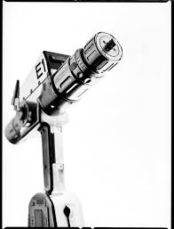
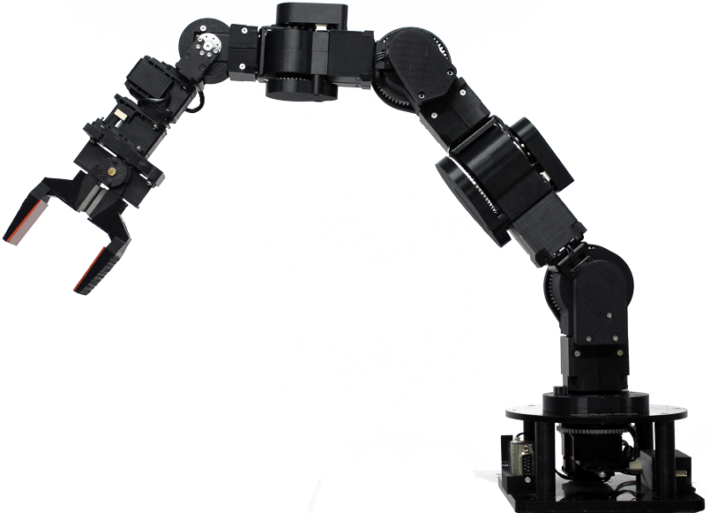
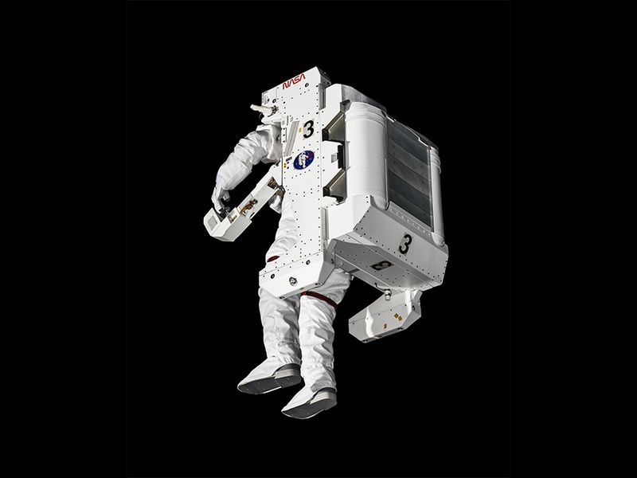
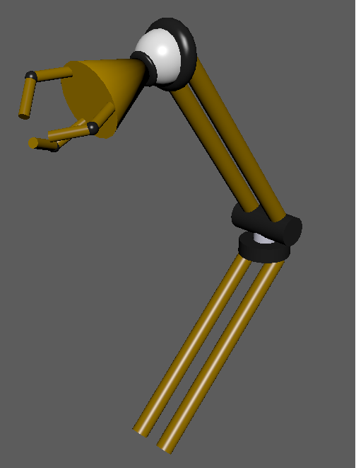
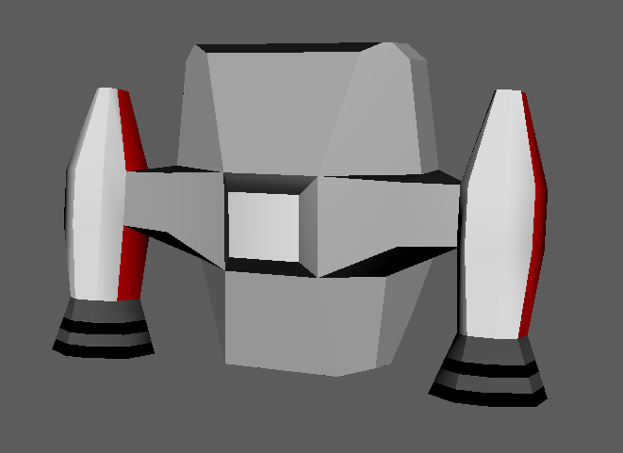
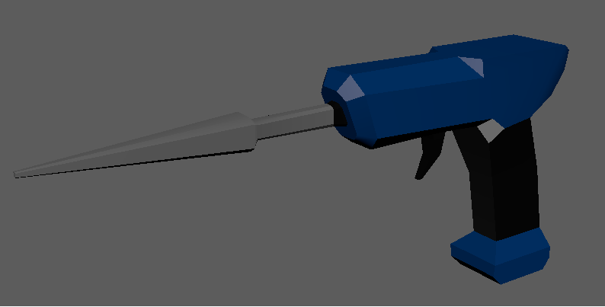
Weapons/Tools
Jetpack Pistol grip Tool Mech Claw

Slide 14
Level Design
Each Boss room designed specifically for select boss fight style and gameplay

Slide 15
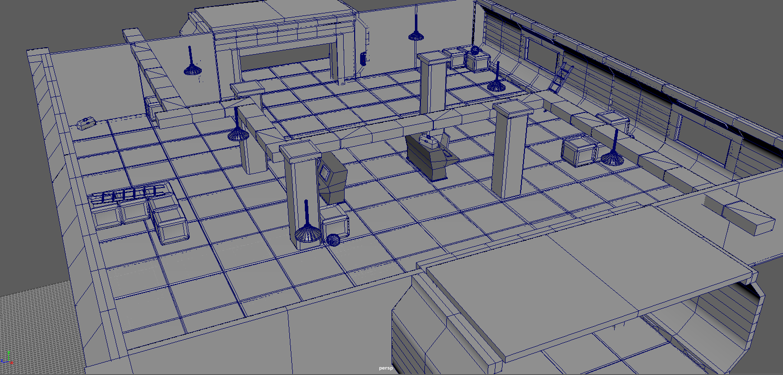
Volski’s Room
This room is created for shooting fights as cover and obstacles litter this level for an advantage to dodge and escape from Volski’s claw beam.

Slide 16
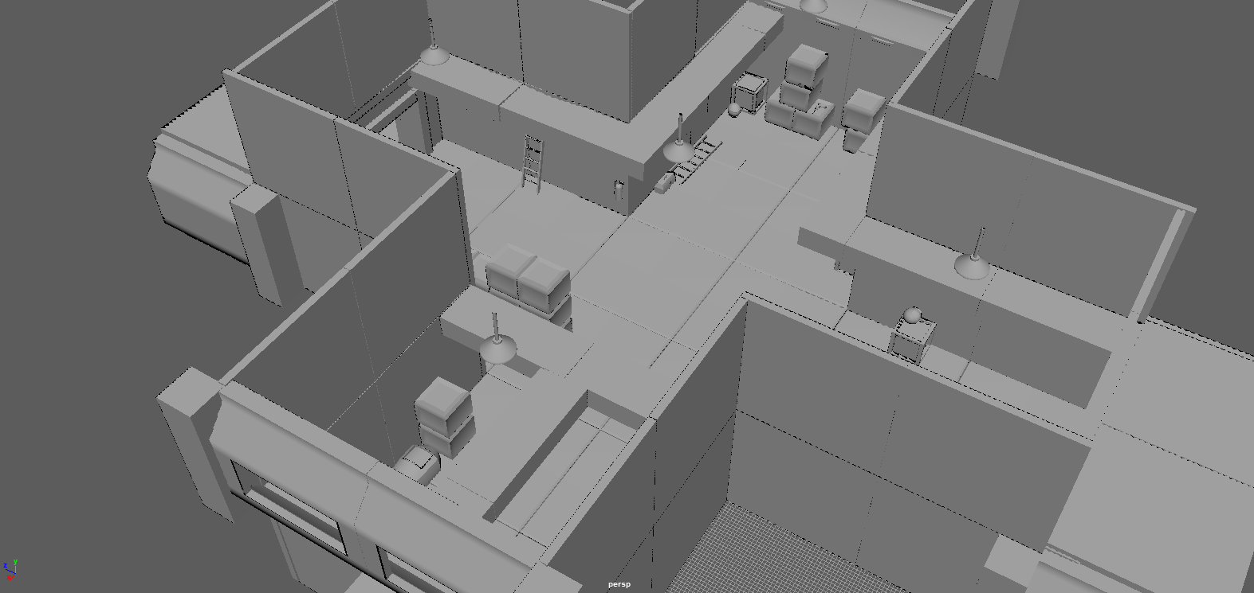
Cerberous Room
Designed with access to upper vents, to be accessed for better vantage and attack positioning.

Slide 17
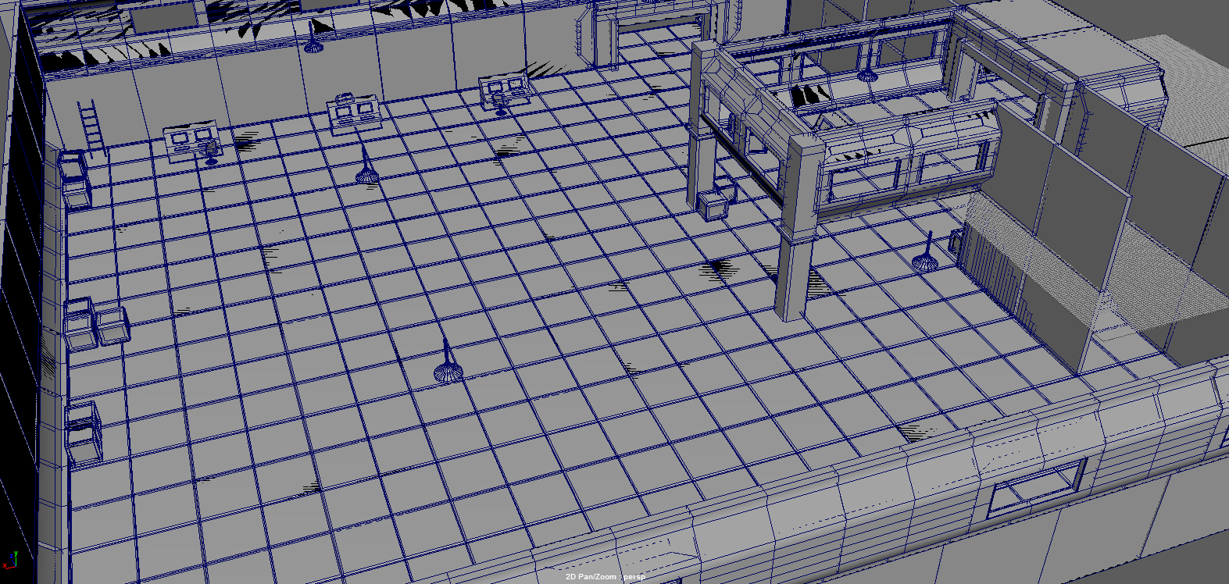
Grabapple Room
This level was built wide and empty as Grabapple’s attack sends objects scattering around the room and towards you. This allows the player much needed maneuverability space to shoot, jetpack, or close in on the boss.

Slide 18
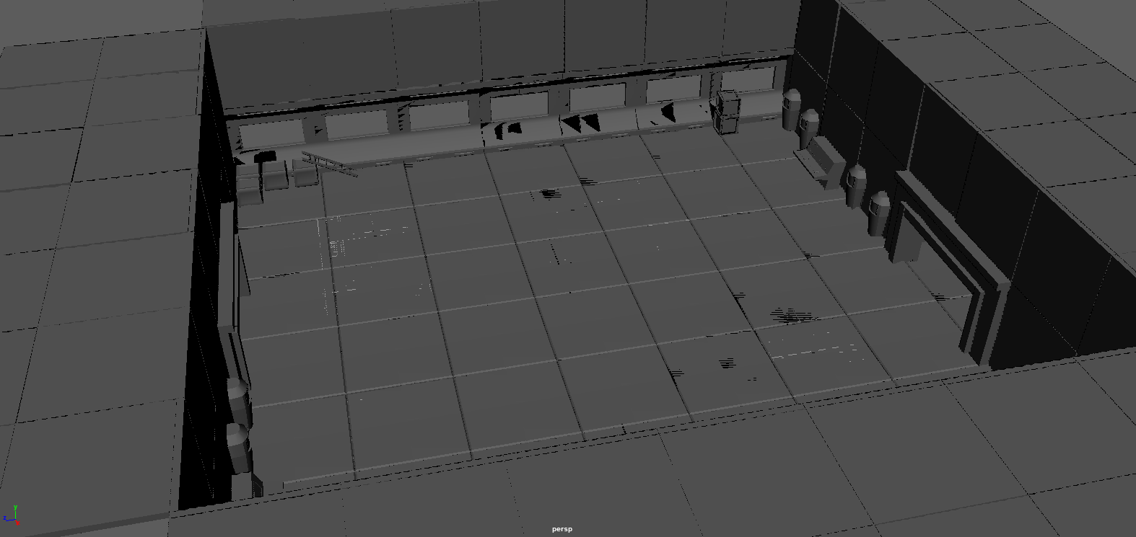
Sensus Sui Room
This boss room was made with ample space in both a horizontal and vertical direction as both you and this boss will have all weapons to use as you see fit, complete with a glass dome!

Slide 19
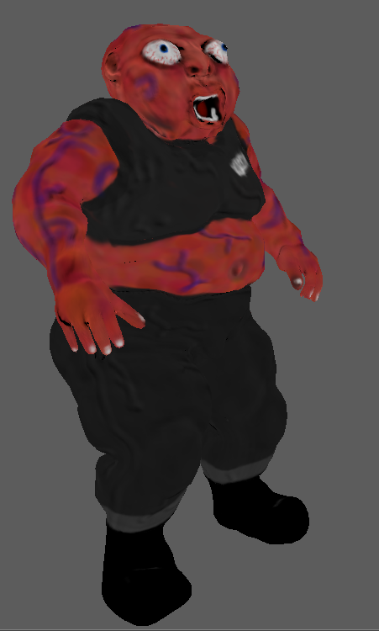
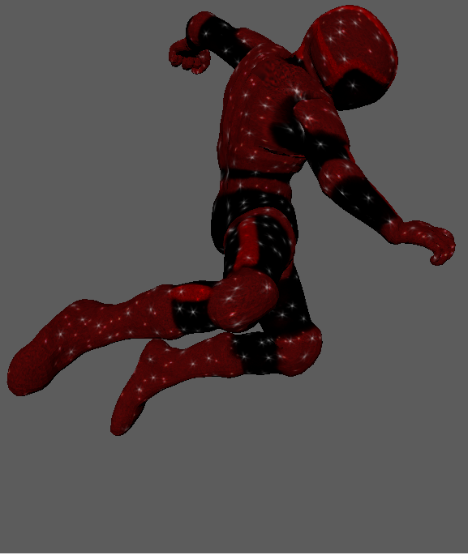
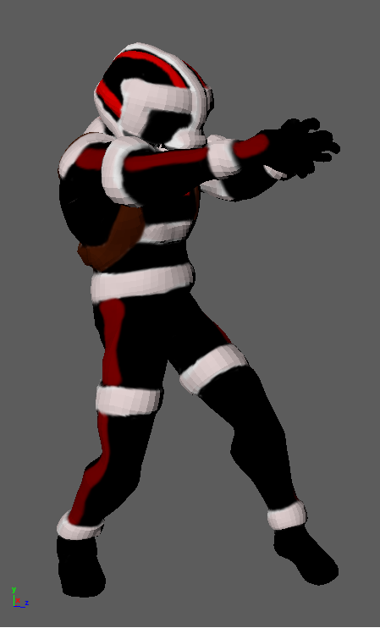
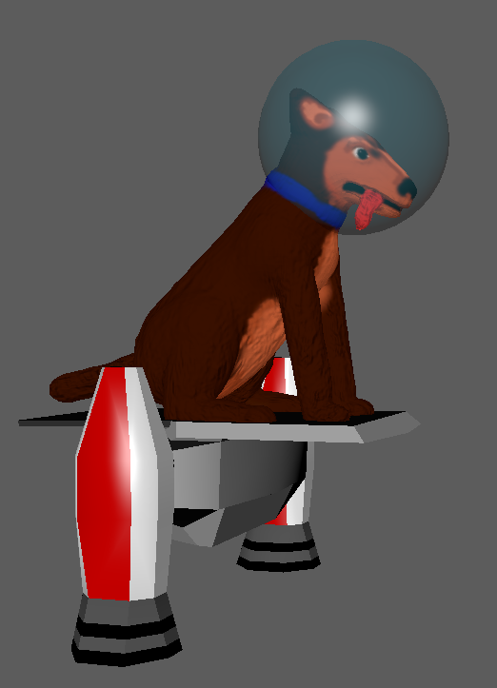
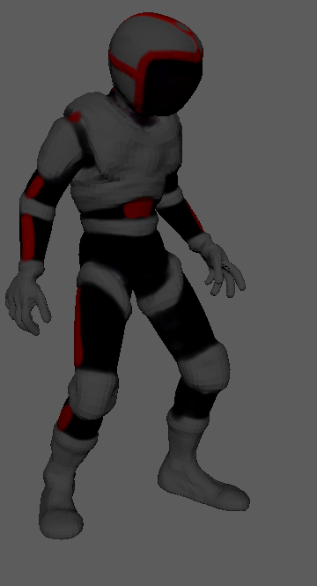
Characters
All past crew members of yours, now mutated physically &/or mentally
Player
Quartermaster Volskoi Cerberus Doctor Grabapple Sensus Sui

Slide 20
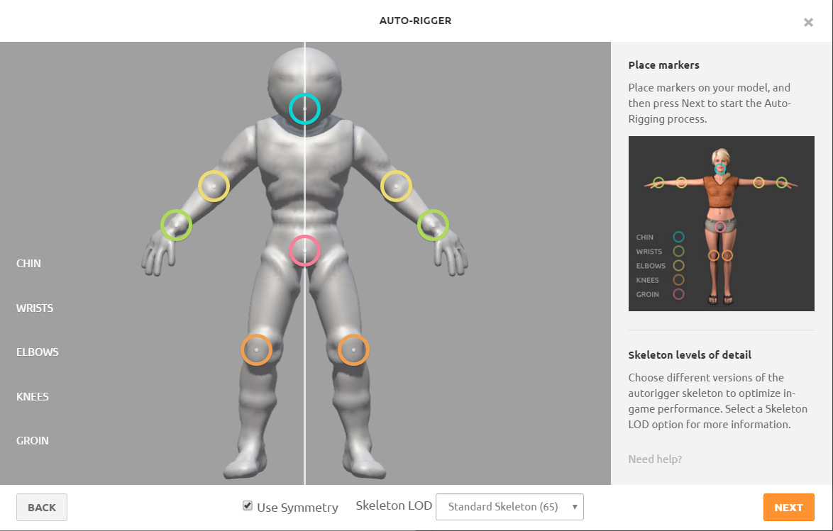
Rigging and Animation
Thanks to Mixamo, I utilized the Autorig feature and discovered I had access to numbers of free animations which I utilized as well.

Slide 21
DEMO VIDEO TIME!

